Slide 1





AVERAGE SOCIAL MEDIA TIME ANALYSIS
// IBM PROJECT | POWER BI DASHBOARD
How 1,000 users spend their time on Instagram, YouTube and Facebook
PRESENTED BY
Abu Talha Aslam Ansari
ROLL NO. 1250645012
FACULTY Shubham Pathak
Notes:
Introduce yourself: Abu Talha Aslam Ansari, roll number 1250645012, under faculty Shubham Pathak. This is the IBM project: a Power BI dashboard that analyses the average time 1,000 users spend on Instagram, YouTube and Facebook.

Slide 2

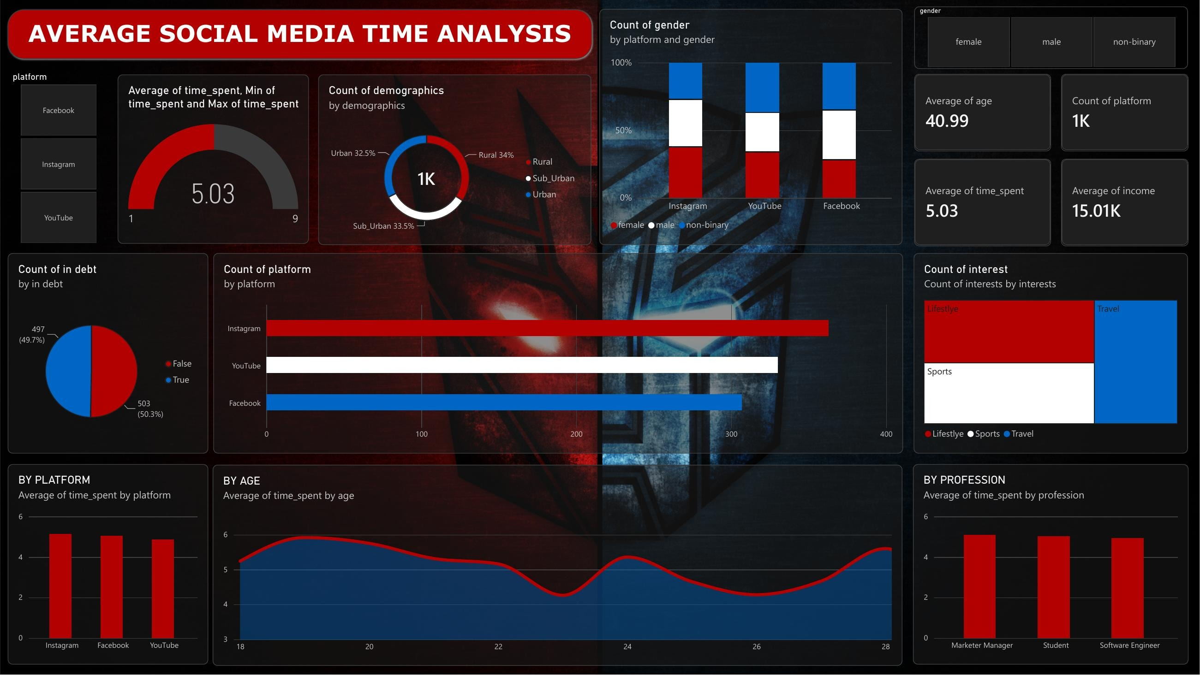
The dashboard behind this report
// 01 THE SOURCE
Notes:
This is the original Power BI dashboard. The next slides explain it piece by piece: headline numbers, time spent, who the users are, the platforms, age and profession, and finally debt and interests.

Slide 3







The dataset at a glance
// 02 OVERVIEW
40.99
1K
5.03
15.01K
AVERAGE AGE
USERS IN THE DATASET
AVG. TIME SPENT (SCALE 1 TO 9)
AVERAGE INCOME
> The dashboard summarises 1,000 users: average age about 41, average income about 15K, and an average time-spent score of 5.03 on a scale that runs from 1 to 9.
Notes:
Four headline numbers from the top-right of the dashboard: average age 40.99, 1K users, average time spent 5.03 and average income 15.01K. The currency and the unit of time_spent are not shown on the dashboard, so describe them only as in the dashboard.

Slide 4



How much time do people spend?
// 03 TIME SPENT
5.03
1
2
3
4
5
6
7
8
9
AVERAGE TIME SPENT
The average sits almost exactly in the middle of the 1 to 9 scale, at about 50% of the range.
MIN
AVERAGE
MAX
1
5.03
9
Notes:
This is the gauge on the dashboard: minimum 1, maximum 9, average 5.03. The average is about halfway between the lowest and highest values.

Slide 5


Who are the users?
// 04 AUDIENCE
1K
USERS
Rural 34%
Sub_Urban 33.5%
Urban 32.5%
Almost a perfect three-way split between rural, sub-urban and urban users.
Gender mix per platform (approximate, read from the dashboard): no platform is dominated by one gender.
Notes:
Left: users are split almost equally across rural (34%), sub-urban (33.5%) and urban (32.5%) areas. Right: gender share per platform, read off the 100% stacked bars, so the percentages are approximate. Red is female, white is male, blue is non-binary, as on the dashboard.

Slide 6


Instagram leads, but only by a small margin
// 05 PLATFORMS
USERS PER PLATFORM
AVERAGE TIME SPENT BY PLATFORM
About 362 users on Instagram, 331 on YouTube and 307 on Facebook (read from the dashboard, approximate).
All three platforms are close to 5 on the time scale; Instagram is highest, YouTube lowest.
Notes:
Left: number of users per platform, about 362 / 331 / 307 (they add up to roughly 1,000). Right: average time spent per platform, about 5.2 / 5.1 / 4.9. All values are read from the charts so they are approximate. The differences between platforms are small.

Slide 7


Time spent by age and by profession
// 06 AGE AND PROFESSION
AVERAGE TIME SPENT BY AGE
BY PROFESSION
Time spent peaks around age 19, dips near 23 and 26, then climbs again by 28 (approximate, age axis 18 to 28 as in the dashboard).
All three professions spend about the same time, close to 5.
Notes:
Left: average time spent for each age from 18 to 28, read from the smoothed line chart, so values are approximate. The highest point is near 19 and the lowest near 23 and 26. Right: by profession, Marketer Manager, Student and Software Engineer are almost the same. Note for Q&A: the age KPI shows an average age of 40.99, while this chart only shows ages 18 to 28.

Slide 8






Debt status and interests are evenly split
// 07 DEBT AND INTERESTS
COUNT OF USERS BY DEBT STATUS
Lifestyle
~34%
Share of interests (approx.)
Sports
~33%
Share of interests (approx.)
Travel
~33%
503 users are not in debt (50.3%) and 497 are in debt (49.7%): essentially half and half.
Share of interests (approx.)
Notes:
Left: 503 users are not in debt and 497 are in debt, so it is almost exactly 50-50. Right: the interest treemap shows Lifestyle, Sports and Travel with nearly equal areas, so each is roughly one third. The percentages are estimated from the box sizes, so call them approximate.

Slide 9


Key takeaways
// 08 SUMMARY
A balanced audience
Instagram leads narrowly
01
02
1,000 users split almost evenly across rural, sub-urban and urban areas.
Most users and the highest average time, but all three platforms are close to 5.
Age shapes the pattern
Groups look alike
03
04
Average time peaks around age 19 and dips near 23 and 26 (ages 18 to 28 shown).
Gender mix, profession, debt status and interests are all close to an even split.
Notes:
Wrap-up: the audience is balanced, Instagram leads by a small margin, time spent changes with age, and most other groups look very similar. In short, social media time is fairly uniform across this dataset.

Slide 10
THANK YOU
// END OF REPORT
Questions are welcome
PRESENTED BY
Abu Talha Aslam Ansari
ROLL NO. 1250645012
FACULTY Shubham Pathak
Notes:
Thank the audience and invite questions.

